Slide 1
Astronomy in Chile: Assessment of Scientific Productivity through a Bibliometric Analysis
Rodrigo Cortés
Denise Depoortere
Lucina Malaver
June 8th, 2017

Slide 2
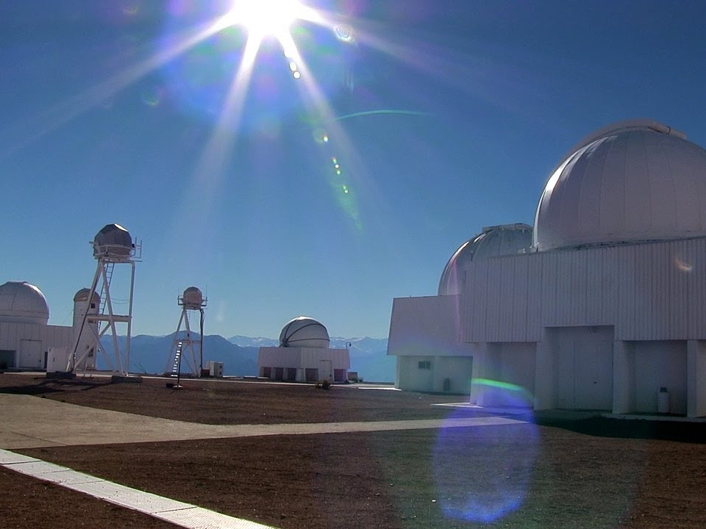
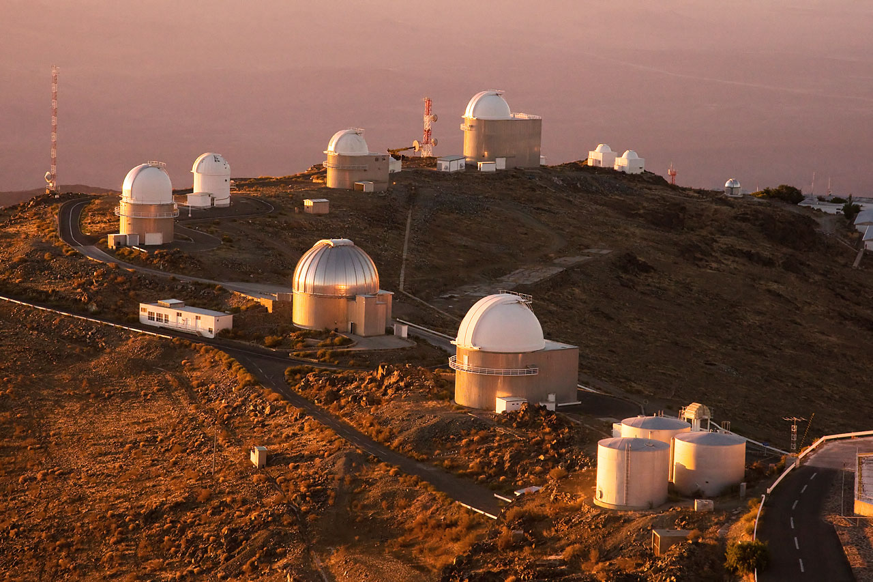
WHY CHILE?
Absence of clouds
Dry soils
Low light intensity or pollution

Slide 3
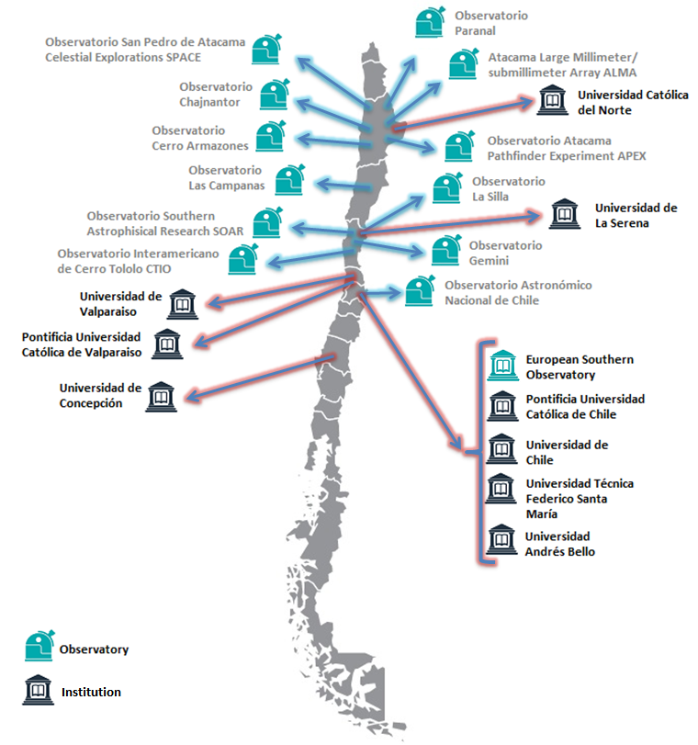
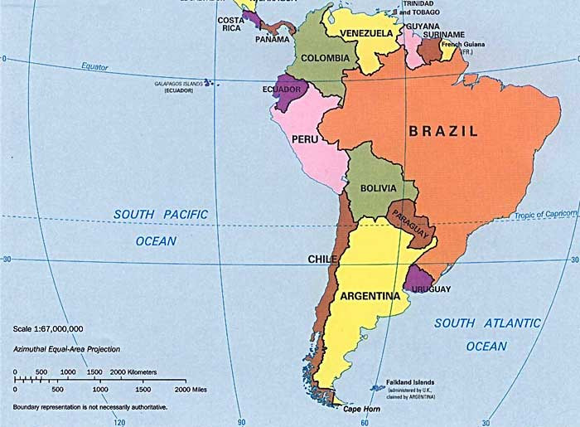
OBSERVATORIES AND INSTITUTIONS IN CHILE

Slide 4
MAIN OBJECTIVES OF THIS WORK:
Show the important increase of the astronomical scientific productivity developed in Chile during the last decade (2005 – 2015) through traditional and alternative metrics.
Specific goals:
To assess the scientific impact of Astronomy in Chile.
Show the scientific astronomical collaboration with Chile.
Analyze Altmetrics indicators in the Chilean scientific production in Astronomy.

Slide 5
HOW WE EXPLORED AND ASSESSED THE DEVELOPMENT OF ASTRONOMY IN CHILE?
Data bases & Bibliometric tools:
Subject category:
ASTRONOMY & ASTROPHYSICS
Period:
2005-2015
Notes:
The methodology adopted in this analysis is essentially exploratory and is based on bibliometric indicators in Incites and complemented with Alternative metrics of SCOPUS.
The data analyzed refer to scientific publications of Chile in the research area of Astronomy & Astrophysics over 10 years.

Slide 6
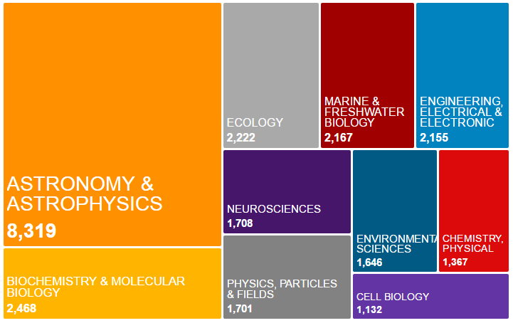
INCITES RESEARCH AREAS IN CHILE 2005 - 2015
PRODUCTIVITY
IMPACT
INTERNATIONAL COLLABORATION
Notes:
The graph shows the focus of scientific investigation in Chile for this period in Incites.
The goal of this bibliometric analysis is on productivity, impact and international collaboration of Chile, analyzing a global perspective and their influence throughout the period in study.
Where?...Here in this field: A&A

Slide 7
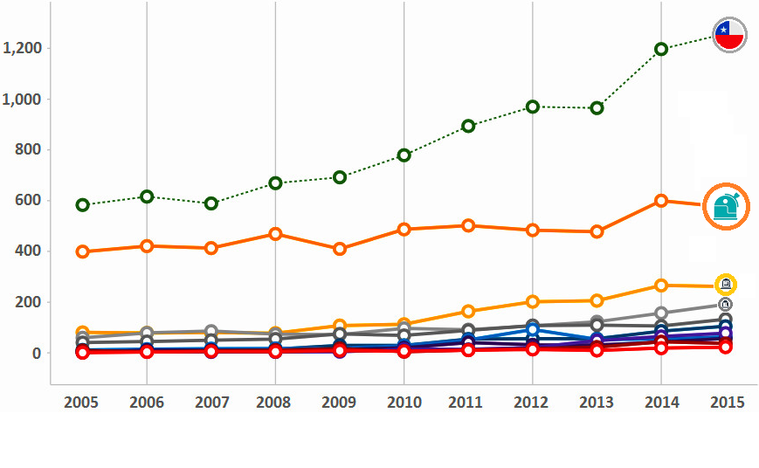
WEB OF SCIENCE - PRODUCTIVITY
Chilean scientific publications experiment a positive growth that influence the development of academic research in this area.
Notes:
The first focus of this bibliometric analysis is on the productivity.
To visualize research trends and growth of knowledge in this scientific field, first we must identify the scientific publications.
The Chilean scientific productivity is identified through the analysis of the author institutional affiliation.
The graph presents the evolution of papers published annually in this field.
Now the graph presents the most productive scientific organizations during the last years.
The European Southern Observatory and Pontifical Catholic University of Chile are the most productive organizations in this area.
The first conclusion, is that: The bibliometric analysis shows Chilean scientific publications experiment a positive growth that influence the development of academic research in this area.

Slide 8
WEB OF SCIENCE - NORMALIZED CITATION IMPACT (NCI)
NCI
>1 above average
1 = world average
<1 below average
Over the last ten years the normalized citation impact of Chilean scientific documents is higher than the worldwide impact in this field.
Notes:
The second focus of this bibliometric analysis is on impact of scientific papers published.
Now we can identify the impact of Chilean scientific production analyzing the times a paper has been cited.
Chilean scientific documents citation was analyzed based on Normalized Citation Impact (NCI).
This measure can be used to evaluate the overall impact of the scientific publications in the category.
Based on this information, we can see that over the last ten years the normalized citation impact of Chilean scientific documents is bigger than the worldwide impact in this field..
The graph shows that Chilean papers citation impact in this field has been over than 20% during the period compare with the worldwide impact average.
Explanation Normalized Citation Impact (NCI)
value equal to 1 represents performance at par with the world average
values above 1 are considered above world average
values below 1 are considered below average

Slide 9
WEB OF SCIENCE - NORMALIZED CITATION IMPACT OF INSTITUTIONS
NCI
>1 above average
1 = world average
<1 below average
Most of the institutions conducting research in Chile in this field are above the worldwide average.
Notes:
The graph displays the impact of Chilean top institutions publishing scientific documents in this field based on citation activity
Most of the institutions conducting research in Chile in this field are above the worldwide average.

Slide 10
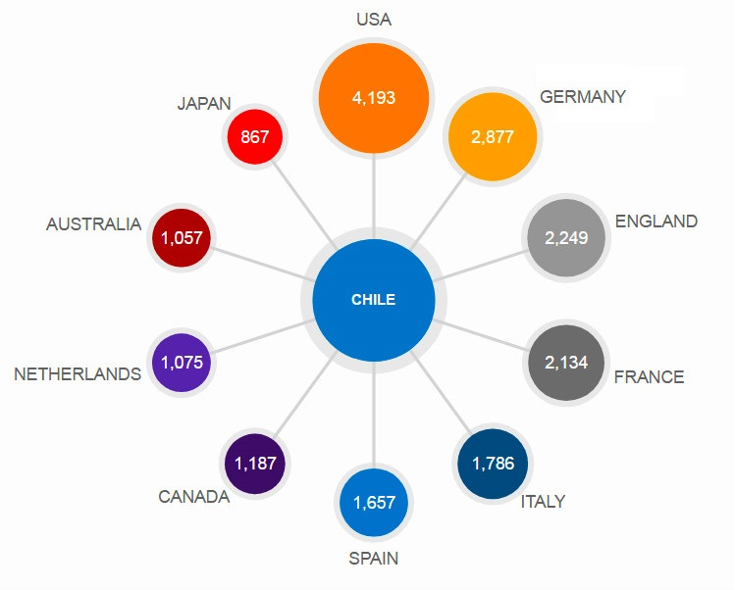
WEB OF SCIENCE - INTERNATIONAL COLLABORATION
International collaboration network of the scientific production between authors of Chilean organizations and other countries, 2005-2015.
Notes:
For exploring Chilean international collaboration by country this bibliometric analysis is based on documents counting.
The figure shows the international collaboration network of the scientific production between authors of Chilean organizations and another countries.
As you can see the US has collaborated with Chile with more than 4.000 documents in the studied period.
Germany, England and France have more 2.000 documents each in collaboration in the same period.

Slide 11
HOW WE OBTAINED ALTERNATIVE METRICS?
Notes:
As we said in the methodology of the study we are complementing the traditional metrics with the alternative ones
The top ten cited papers in WoS were analyzed in SCOPUS looking for the alternative metrics in this four fields: Scholarly Activity, Scholarly Commentary, Mass Media and Social activity.

Slide 12
TRADITIONAL METRICS VERSUS ALTERNATIVE METRICS
Notes:
Comparing traditional metrics with alternative metrics, we can see that
The altmetrics presented by the SCOPUS database reflect that the impact of Chilean research in Astronomy and Astrophysics is much lower in the context of social networks in the studied period.

Slide 13
CONCLUSIONS
Steady increase of Chilean scientific production in Astronomy and Astrophysics.
The Citation Impact of Chile in this field is above the mean at a worldwide level.
Altmetrics presented by SCOPUS show that the impact of the research is low in the context of social networks.

Slide 14
Thank you!

