Slide 1
Sensible Bibliometrics™
Where bibliometrics are sensible
Michael J. Kurtz
Harvard-Smithsonian Center for Astrophysics

Slide 2
Reads and Cites have log-normal distributions

Slide 3
Reads and Cites
measure the same thing (about), but have different systematics

Slide 4
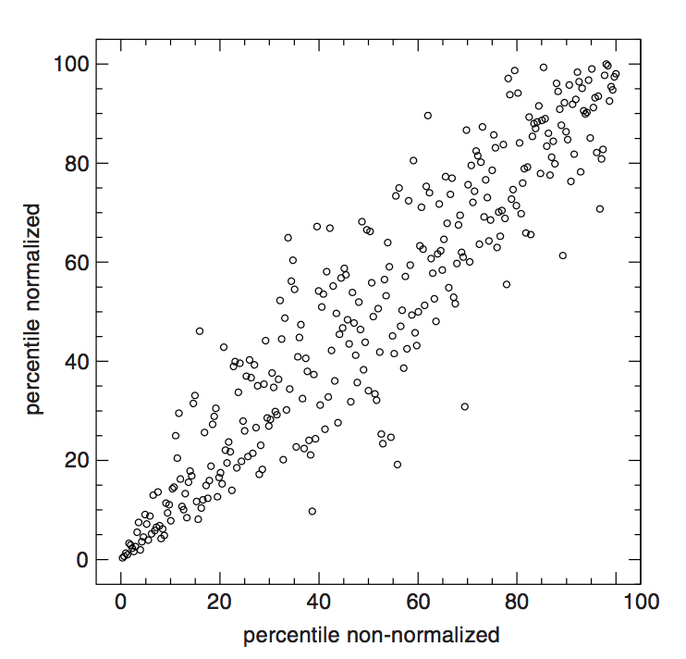
Reads and Cites must be normalized for number of authors

Slide 5
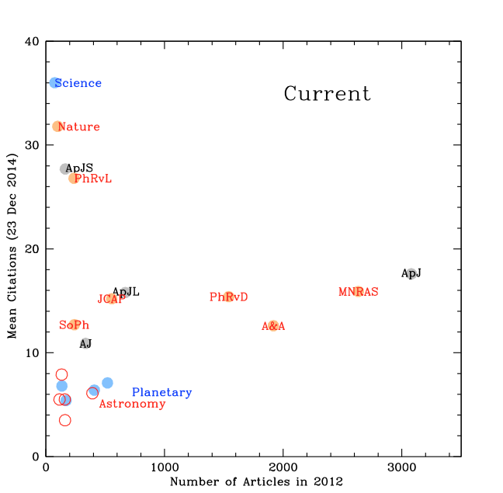
Reads and Cites must be normalized for discipline differences

Slide 6
Cites increase quadratically with age
Number of citations
per paper increases
with time
Number of papers
increases with time
Total citations:
C ~ t²

Slide 7
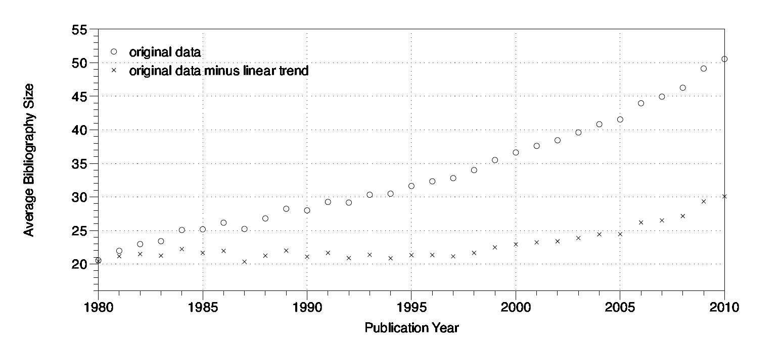
The number of references (and thus cites) changes with time

Slide 8
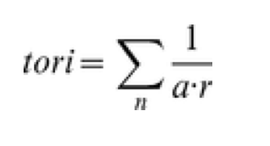
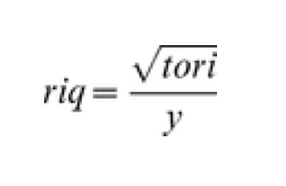
TORI is a double normalized statistic, both by the number of authors in the cited article, and the number or references in the citing article
RIQ is independent of age

Slide 9
How Accurate are Bibliometric Measures?
Use cross comparisons of different measures on the same papers, grouped by person

Slide 10
Examine Reads/Cites
for astronomers with PhD in 1974+/- 2
(with full career research records and no other problem: no outliers)
Papers written 1991-2001
Papers written before 1991
Reads in 2001
Reads in 2012
Citations in 2012 (for 1991-2001 papers only)

Slide 11
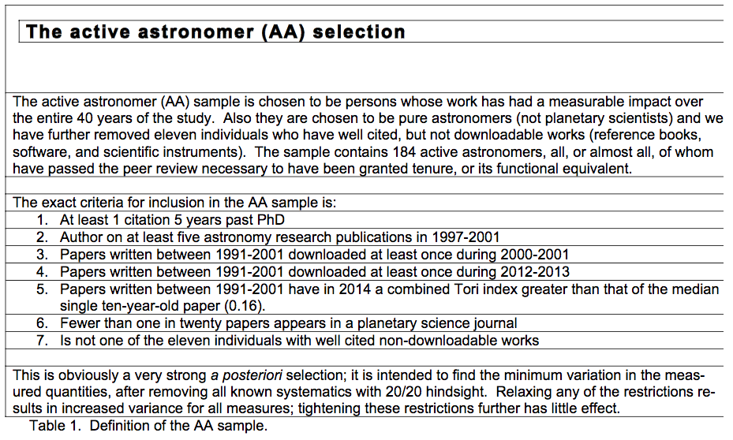

Slide 12
Results:
4 measures of σ
0.20,
0.17,
0.15,
0.15 dex
Mean σ
0.17 dex

Slide 13
A 1σ scatter of 0.17 dex means that
for one to be able to say with 95% confidence (2σ) that one person’s bibliometric measures are higher than another’s those measures must be 0.34 dex, a multiplicative factor of 2.18 larger.
This assumes that all issues with age, discipline, and (co-)authorship have been removed.

Slide 14
How accurately do citations predict the future?
Compare citations 5 years past the PhD with reads 27 years past the PhD.
Use only consistent high performers.

Slide 15
Assuming great prescience, and taking the 49 (out of 922) from the top 10% of 5 year citations who were still active 40 years later:
The 1σ scatter is 0.395 dex, a multiplicative factor of 2.5. Differences less than that are not significant as predictors of future performance.

Slide 16
The Rule of Thumb
When comparing candidates at the assistant professor level citation differences less than a multiplicative factor of three are not significant and should be ignored.

Slide 17
How do bibliometric methods for evaluating people compare with human evaluations?
Test: compare early career prize committee results with citation counts after 30 years

Slide 18
Sample 1: Winners of an AAS early career prize (5 years past PhD) from 1971-1990. 49 individuals
Sample 2: The top 49 individuals measured by the tori citation statistic 5 years past the PhD, from the 1972-1976 US PhD cohort

Slide 19
Result: The AAS sample has 9 members of the National Academy of Science; the citation sample has 8.
The citation sample has individuals who have left research (government, industry, literature) the AAS sample does not.

Slide 20
Conclusion: Human judgment and bibliometric measures are very similar in their ability to predict future performance. They do not, however, predict the same people, in general.

Slide 21
Sensible Bibliometrics™
Where bibliometrics are sensible
Measuring Metrics – A forty year cross-validation of citations, downloads, and peer review in Astrophysics (JASIST 2017)
Finding and Recommending Scholarly Articles (Bibliometrics and Beyond 2015)
A Measure of Total Research Impact Independent of Time and Discipline (PLoSONE 2012)
Usage Bibliometrics (ARIST 2010)

