Slide 1
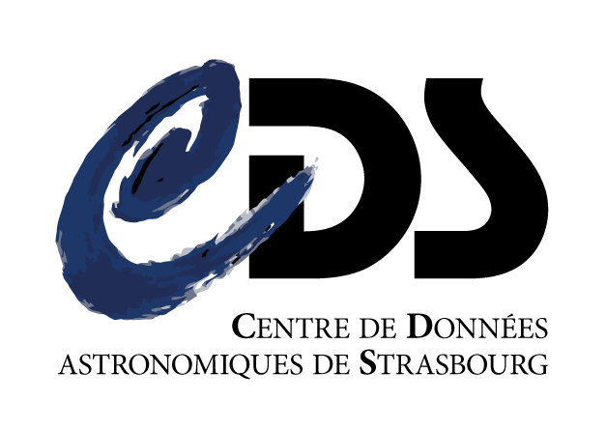
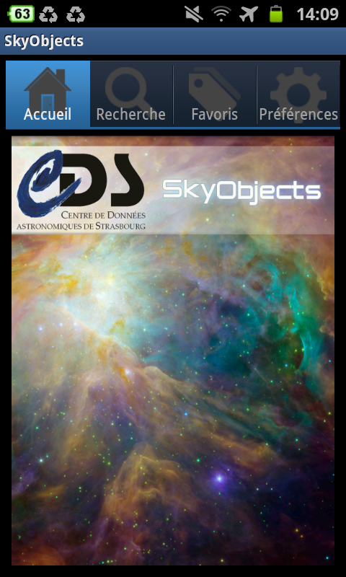
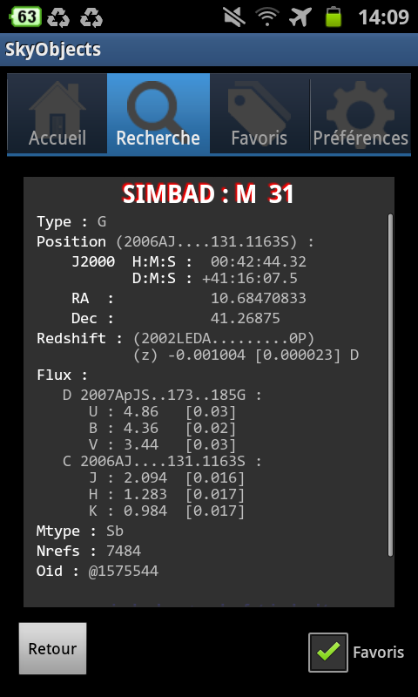
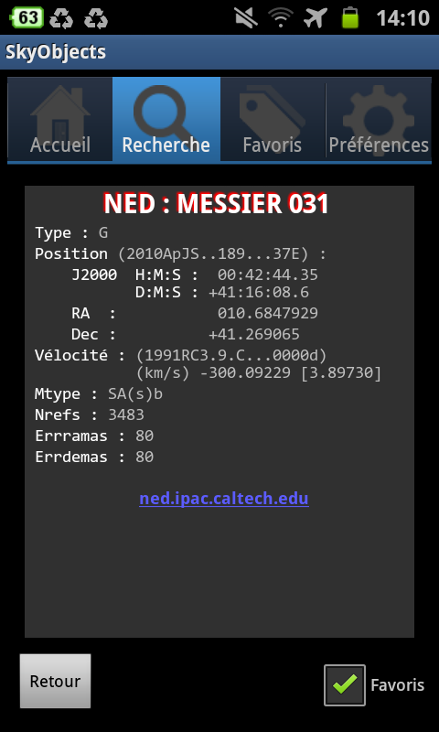
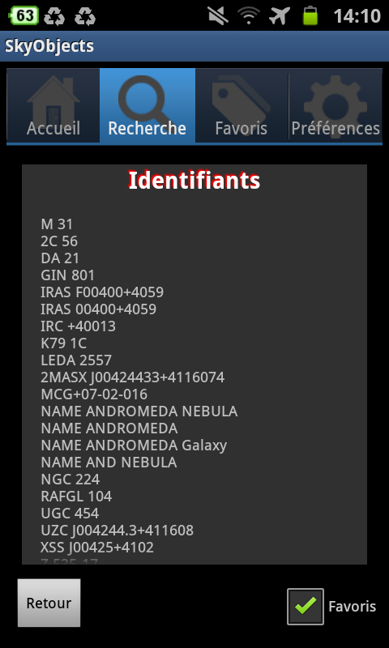
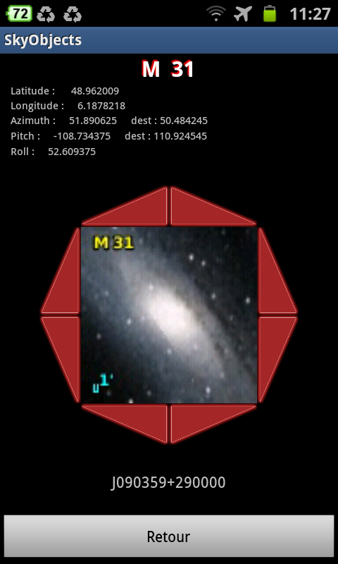
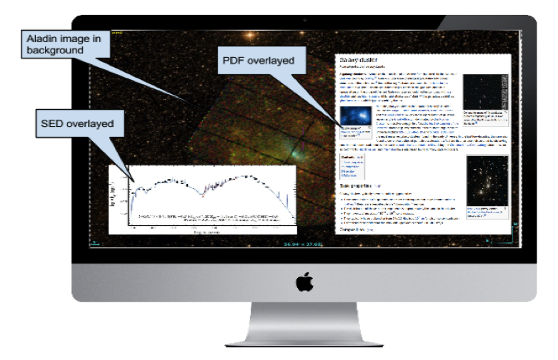
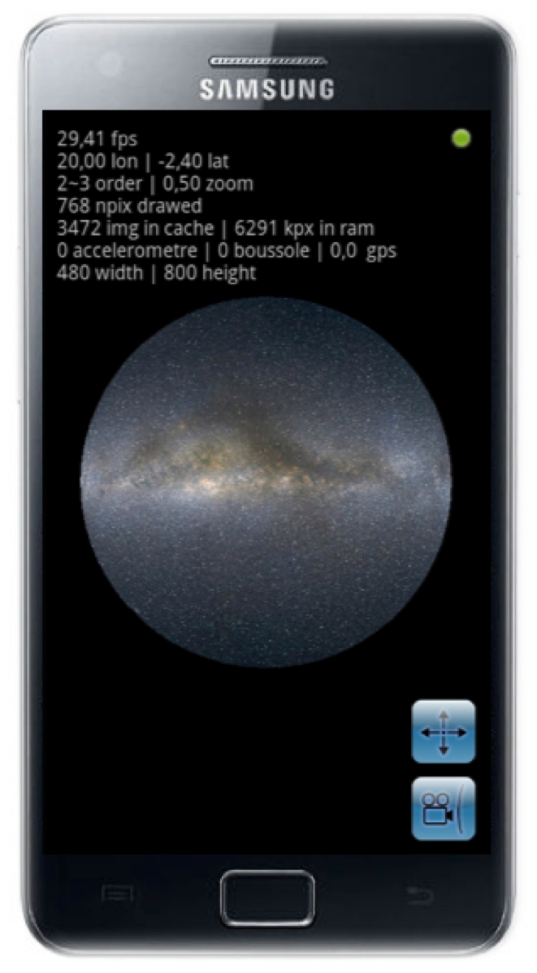
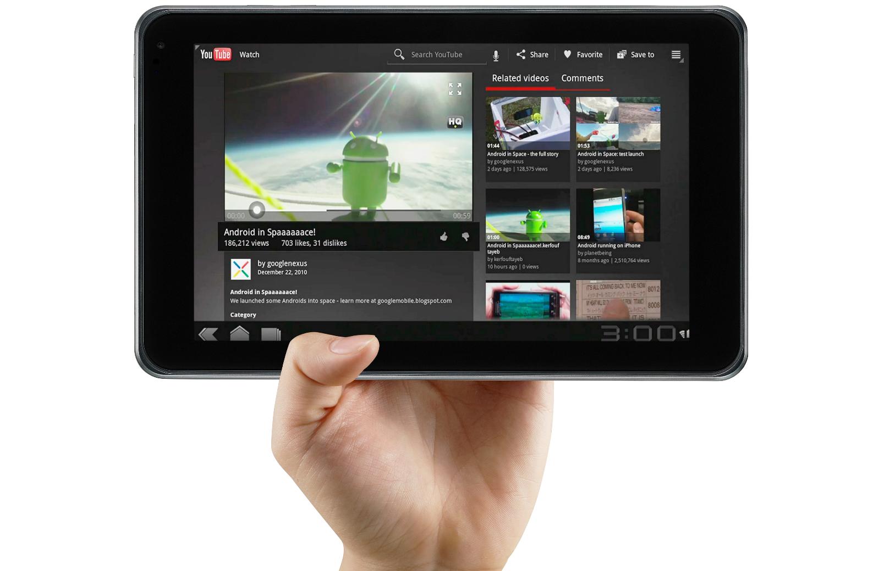
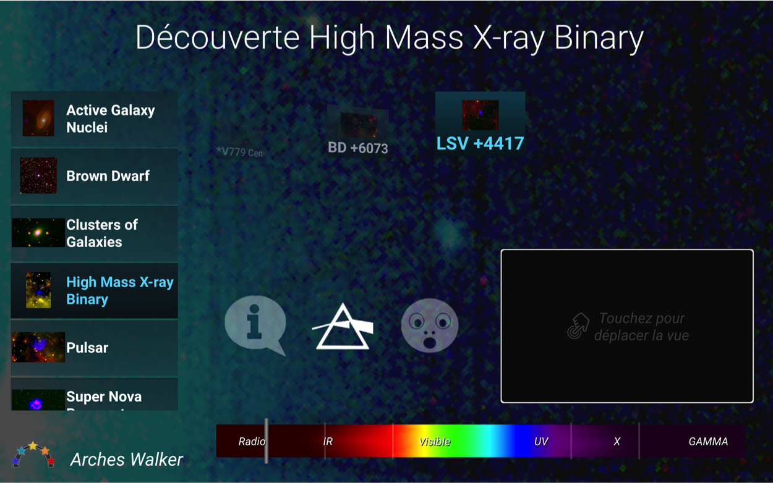
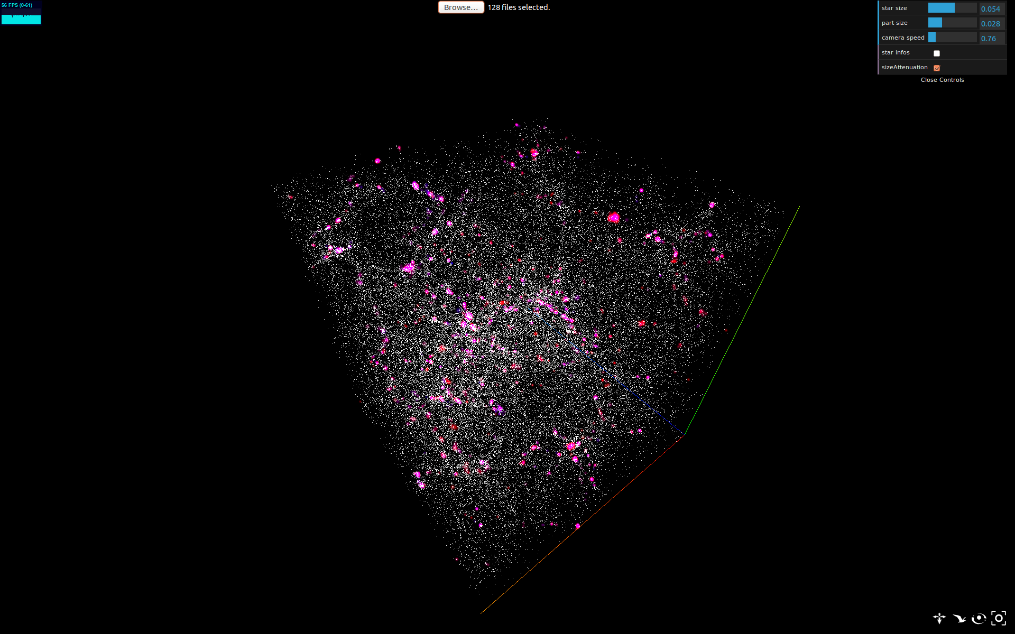
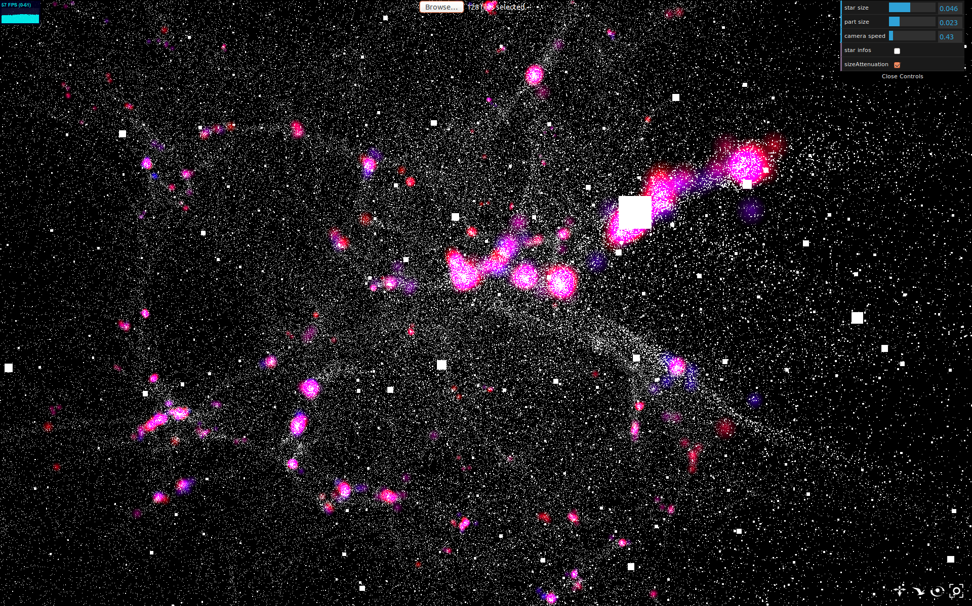
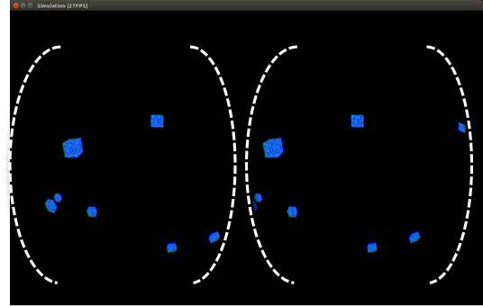
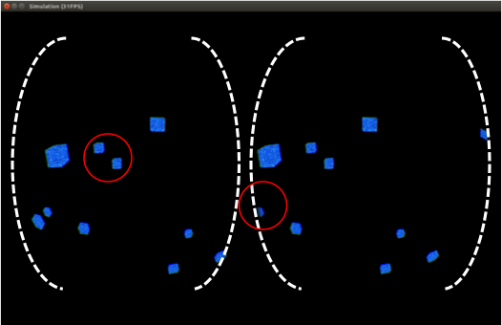
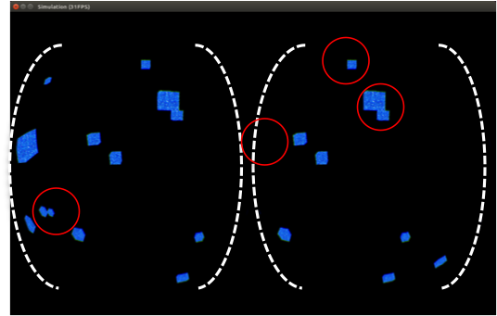
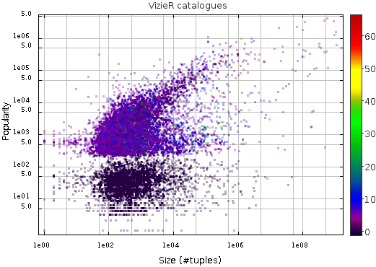
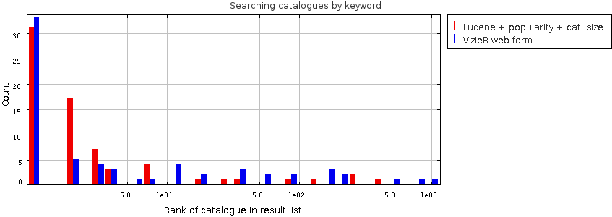
Research & Development at
Schaaff¹, T. Boch¹, N. Deparis¹, S. Derriere¹, P. Fernique¹, N. Gillet¹, G. Landais¹, L. Michel¹, A. Oberto¹, P. Ocvirk¹, Y. Bisch², J. Da Rocha³, V. Ehkirch⁴, P. Gaultier⁵, M. Heckel⁵, R. Houpin³, V. Kaestle⁵, A. Steinmetz⁴
Observatoire astronomique de Strasbourg UDS CNRS¹,
I.U.T. Charlemagne Université de Lorraine²,
Telecom Nancy³,
I.U.T. Schuman Université de Strasbourg⁴,
E.N.S.I.I.E. Strasbourg⁵
The CDS has a long tradition of Research and Development to improve its services and to integrate the new technologies which are interesting and which have a good chance to « survive ».
Mobile devices…
Aladin remote control with Arches Walker, an app, running on android..
(ARCHES - Funded by the 7th Framework of the European Union)
SkyObjects pointing to M31.
A small android app to retrieve basical information about astronomical objects through the Sesame name resolver and with a pointing capability (user interface in english or french).
SkySurveys, a sky atlas for the navigation in HEALPix surveys, based on OpenGL.
Visualization, Virtual Reality, …
Visualization with three.js / WebGL of simulation data
Experimenting octrees with the Oculus Rift (DK1 & DK2)
JDEV 2015 Bordeaux – Observatoire de Strasbourg – UDS – CNRS - CDS
Information retrieval, text mining, …
Set of 50 common keywords used to query in 70 relevant catalogues
2mass 2MASS hipparcos usno Hipparcos USNO IRAS ucac2 ascc tycho nomad sdss
veron
iras Tycho2 cutri kharchenko gsc rosat NVSS ucac SDSS henry gezari GSC
Tycho
NOMAD renson et al temperature Salim houk distance nvss msx hip renson radial velocity landolt RC3
Kharchenko parallax abundance rc3 diameters MSX Glushneva Cutri hde UCAC2 nordstorm
Size and popularity of the VizieR catalogues used during the experiment
and also around Big Data (Hadoop, Spark), log mining, clouds, etc.

